Slide 1


Revision Quiz
Year 10

Slide 2
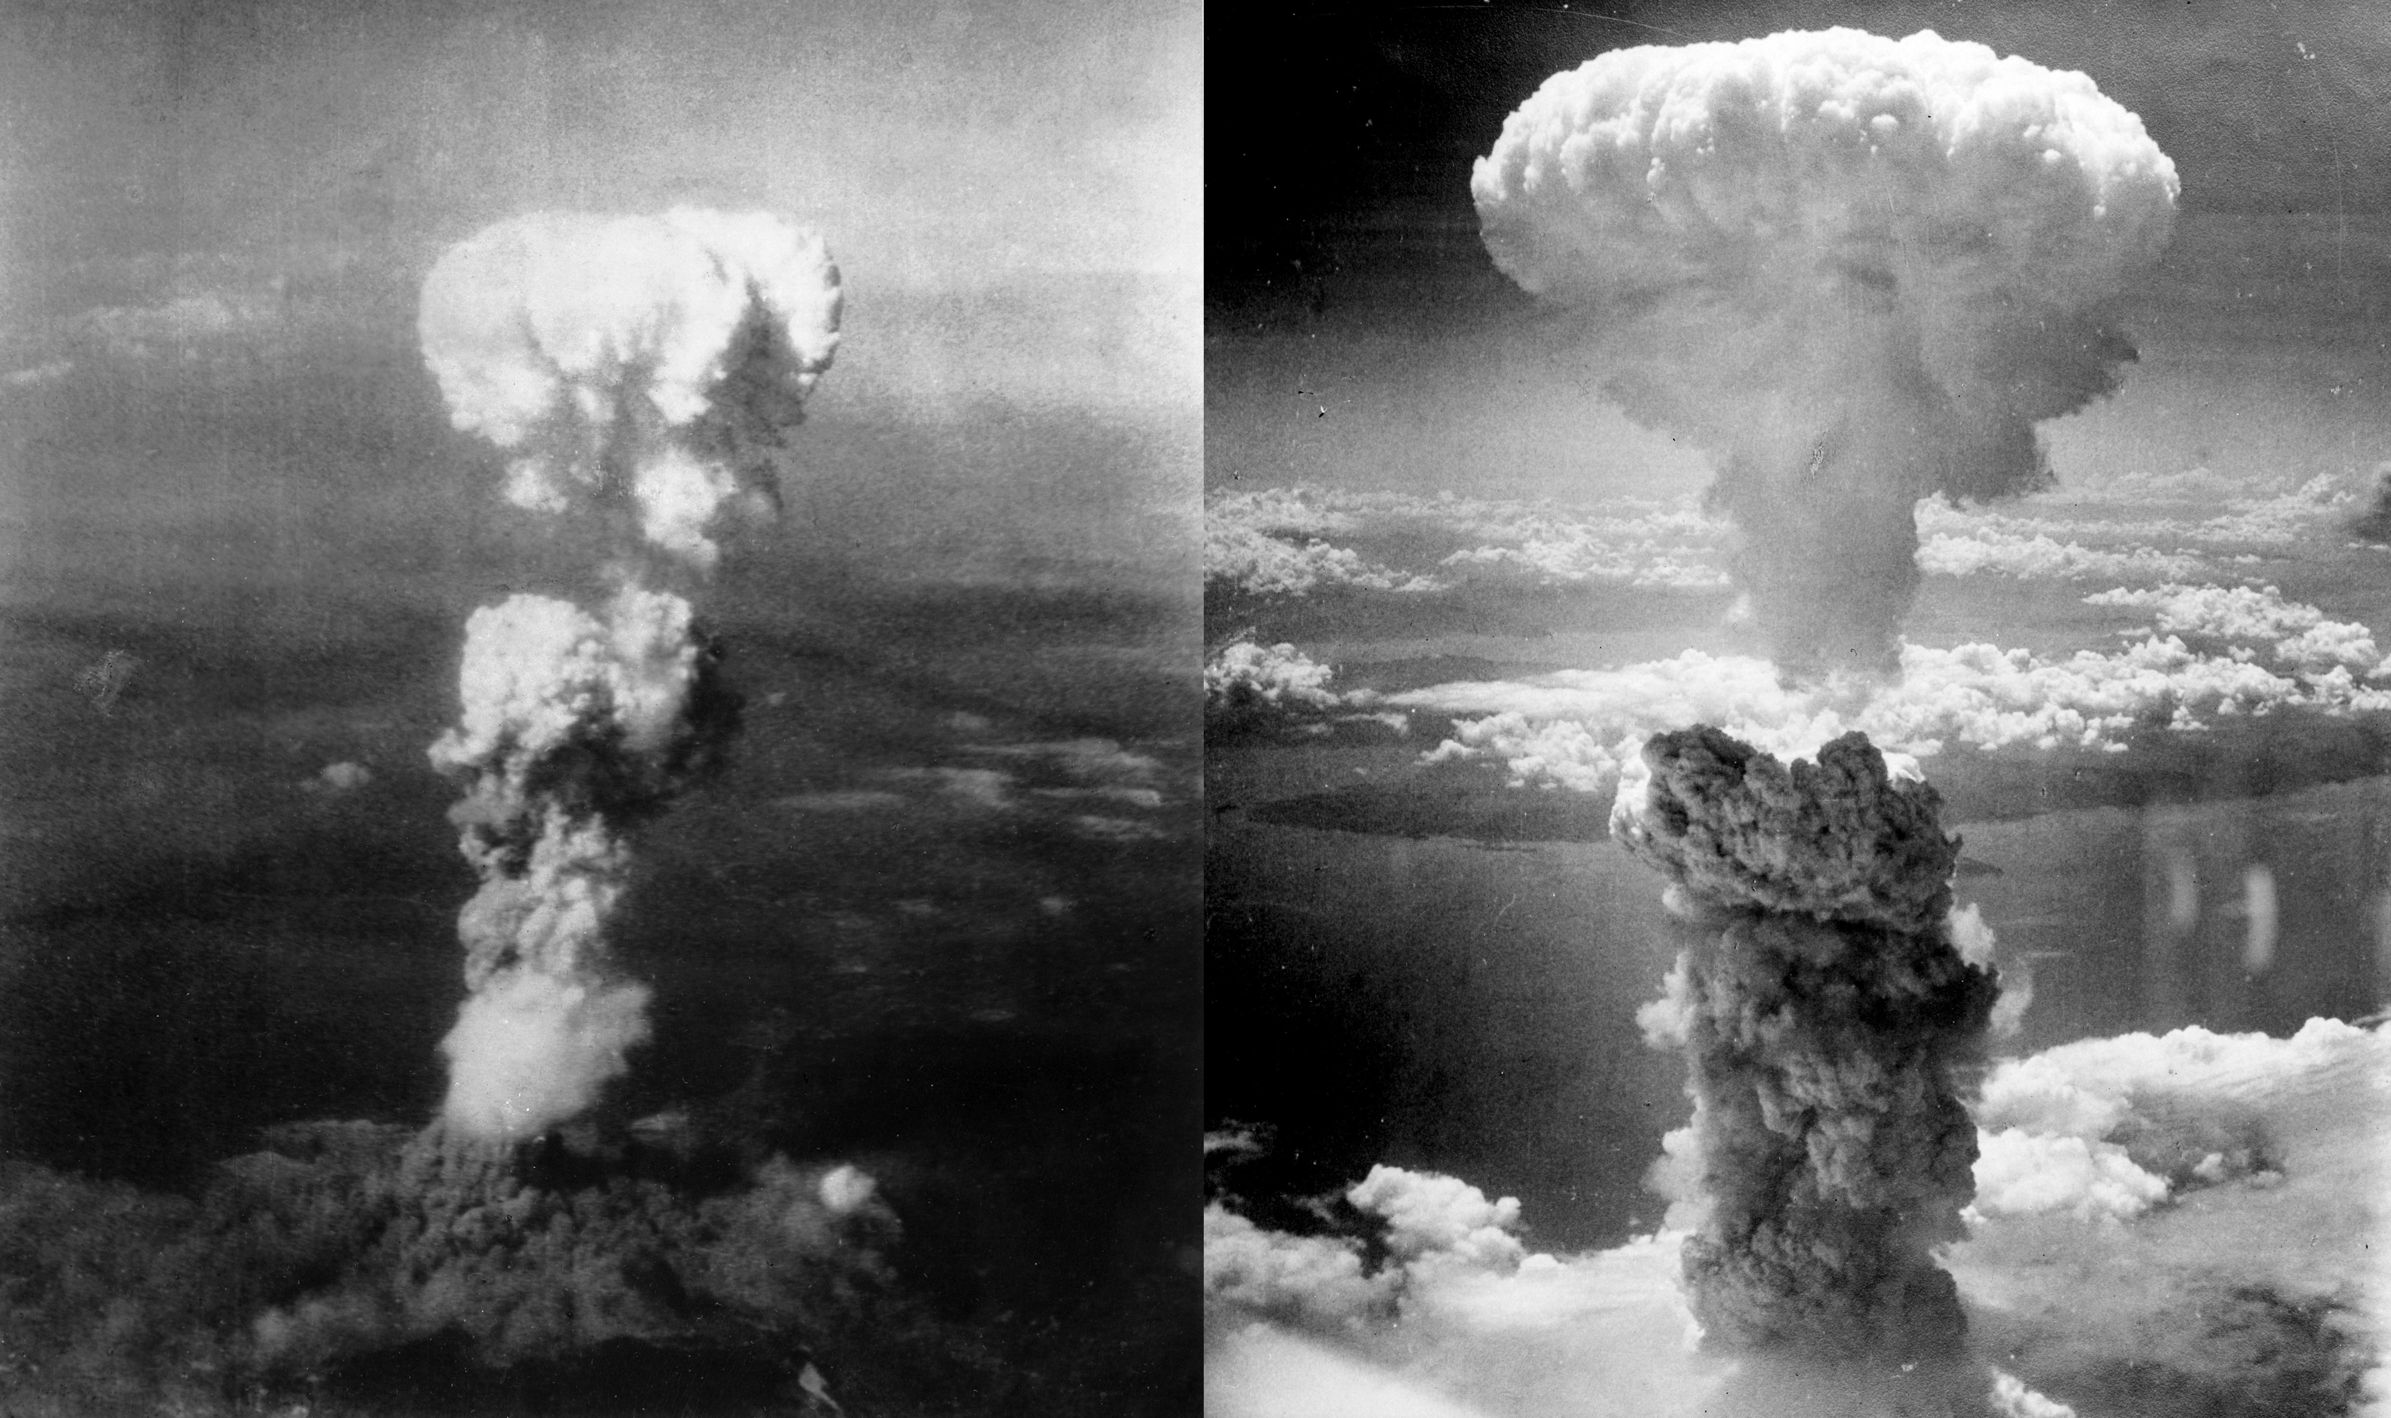
1. During which year were the atomic bombs dropped?
1918
1940
1945
1845

Slide 3
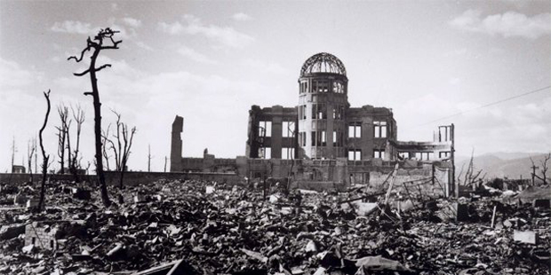
2. In which two cities were the atomic bombs dropped?
Hiroshima and Fukushima
Nagasaki and Hiroshima
Toyko and Nagasaki
Fukushima and Truman

Slide 4

3. Who was the president of the USA who ordered the atomic bombs to be dropped?
John F. Kennedy
Woodrow Wilson
Franklin D. Roosevelt
Harry S. Truman

Slide 5
4. Which of the following is NOT an argument against the atomic bombs?
The Japanese were warned to surrender and still didn’t quit, which would have lead to further destruction anyway
The USA did not wait long enough between the bombs to allow Japan to surrender
The bombs caused massive destruction and the killing of innocent civilian lives
Hiroshima and Nagasaki were not military targets

Slide 6
5. Why did the USA declare war on Japan?
After Japan stole their oil in the Pacific ocean
Because Japan had invaded Manchuria in a brutal way
Due to Japan bombing Pearl Harbour
Due to German invading Poland

Slide 7
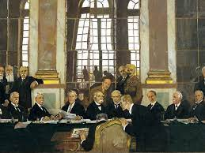
6. What was the purpose of the Treaty of Versailles?
To place severe conditions on Germany to cripple them and force them to take blame for WWI
To show how powerful Germany could be
To place severe conditions on Germany to cripple them and force them to take blame for WWII
To form an alliance between Germany and the Big 3

Slide 8
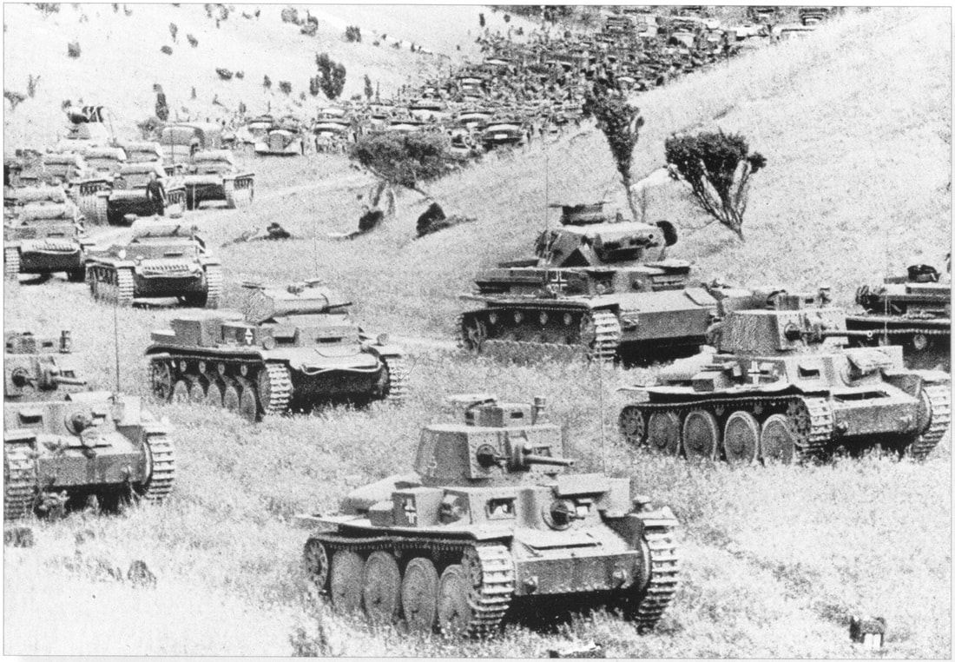
7. What is the name given to the high-speed tactics used by Germany in WWII to invade Poland and many other countries?
Lebensraum
Soldaten
Wehrmacht
Blitzkrieg

Slide 9
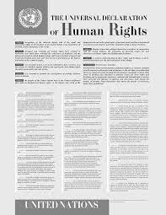
8. Why was the Universal Declaration of Human Rights written?
Because the League of Nations failed
As a result of the Civil War
As a result of the Holocaust and WWII
Because Eleanor Roosevelt was a powerful leader

Slide 10

9. What is the historical significance of the UDHR?
It started a new country
It established new laws
It abolished slavery around the world
It attempted to get all countries to acknowledge that freedom and equality (among other rights) should be universal

Slide 11
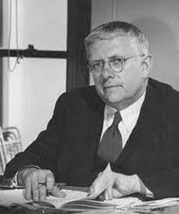
10. What is name of the Australian who played a significant role in the formation of the United Nations?
Robert Menzies.
Franklin D. Roosevelt.
Paul Keating.
Herbert V. Evatt

Slide 12
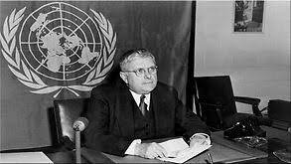
11. What role did Doc Evatt play in the creation of the Universal Declaration of Human Rights??
He was elected the third President of the General Assembly of the UN.
oversaw the vote by the UN countries to accept the UDHR.
persuaded the then sceptical Australian Government to vote in favour of the Universal Declaration.
All of the above.

Slide 13
12. How many articles are written in the Universal Declaration of Human Rights??
20
35
30
12

Slide 14

13. What is the name of the organisation which formed in 1945 and developed the UNDHR?
League of Nations
Circle of Nations
Unified Nations
United Nations

Slide 15
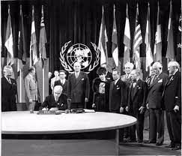
14. In which year was the United Nations formed?
1940, during WWII
1945, after WWII
1918, after WWI
2020, during the COVID outbreak

Slide 16
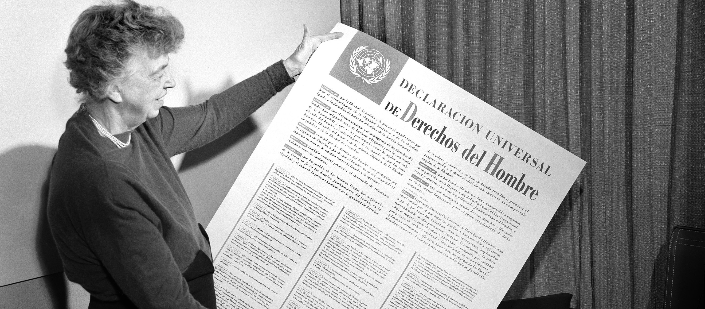
15. Who is this woman?
Eleanor Roosevelt
Queen Mary II
Hansa Mehta
Angela Merkel

Slide 17
16. Which country did Eleanor Roosevelt represent when writing the UNDHR?
England
The USA
Australia
Germany

Slide 18
17. Which of the following best describes ‘racial segregation’?
Forcing two groups of people to live together in harmony
The separation of people into racial or ethnic groups in daily life
The process of which a minority group or culture comes to resemble the majority group
When all racists are separated from each other

Slide 19
18. What is an economic boycott?
Stopping people from contributing to the economy
Refusing to spend money on a particular person, business or service
A violent form of protest which can lead to death and injury
An illegal form of protest which caused the FBI to hunt down Martin Luther King Jr.

Slide 20
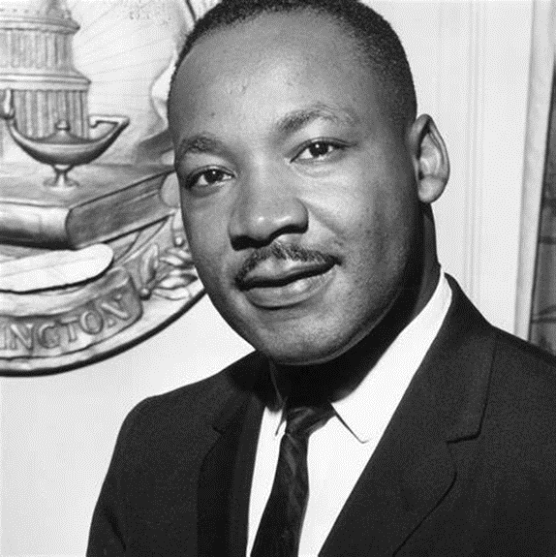
19. Who delivered the famous ‘I have a dream’ speech in 1963?
Rosa Parks
John F. Kennedy
Martin Luther King
Martin Luther King Jr.

Slide 21
20. What was the purpose of the march on Washington in 1963 which was attended by over 250 000 people?
To put pressure on the US Congress to enact the Civil Rights Act, which was a bill by President Kennedy to outlaw discrimination based on race or gender.
To prevent the US Congress from passing the Civil Rights Act as it was racist
To change the way that black people were seen in society
For Martin Luther King Jr. to tell everyone about his dreams from the previous night

Slide 22
21. Why did Martin Luther King Jr. model his civil rights activism on Mahatma Ghandi?
He was King’s grandfather and taught him about peace and love above violence
He practiced ‘Satyagraha’ which was a non-violent form of protest and encouraged protesters to see the power of truth and love
He encouraged protesters to boycott local bus businesses in India
Ghandi played a key role in the Indian civil rights movement

Slide 23
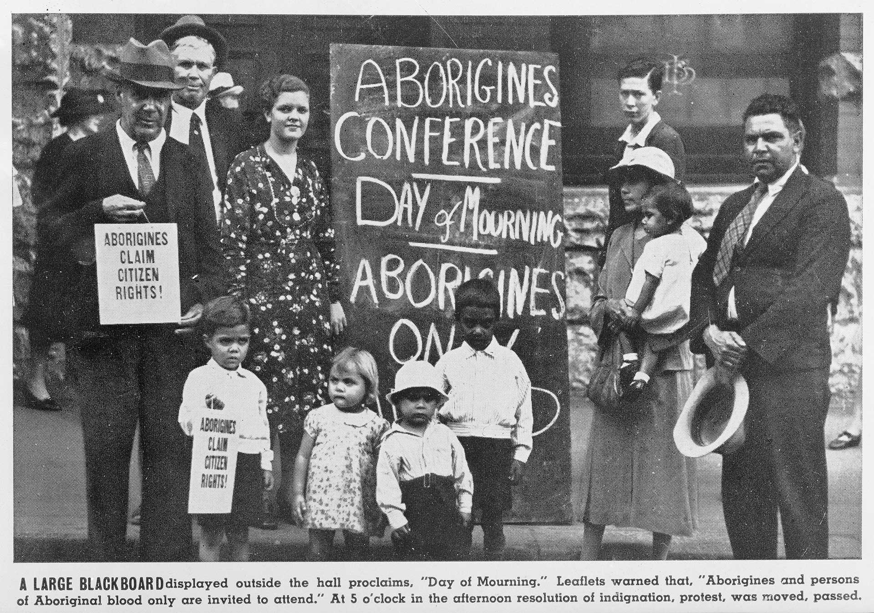
22. On what dates was the first ‘Day of Mourning’ held?
1st January 1901
26th January, 1788
26th January, 1938
10th December, 1948

Slide 24
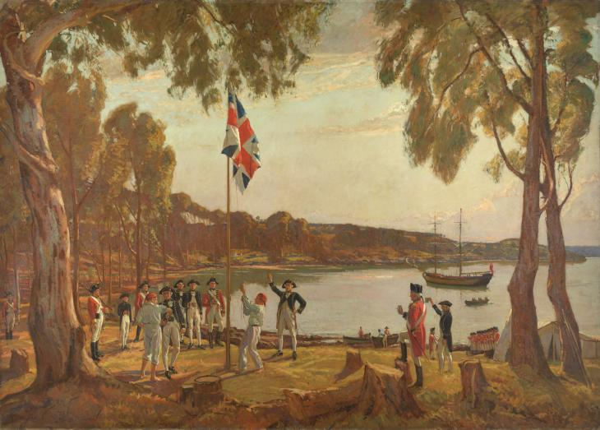
23. What was Australia proclaimed as upon arrival of British settlers in 1788?
Van Diemen’s Land
The land of the long white cloud
Stolen
Terra Nullius

Slide 25
Answers

Slide 26
1. During which year were the atomic bombs dropped?
1918
1940
1945
1845

Slide 27
2. In which two cities were the atomic bombs dropped?
Hiroshima and Fukushima
Nagasaki and Hiroshima
Toyko and Nagasaki
Fukushima and Truman

Slide 28
3. Who was the president of the USA who ordered the atomic bombs to be dropped?
John F. Kennedy
Woodrow Wilson
Franklin D. Roosevelt
Harry S. Truman

Slide 29
4. Which of the following is NOT an argument against the atomic bombs?
The Japanese were warned to surrender and still didn’t quit, which would have lead to further destruction anyway
The USA did not wait long enough between the bombs to allow Japan to surrender
The bombs caused massive destruction and the killing of innocent civilian lives
Hiroshima and Nagasaki were not military targets

Slide 30
5. Why did the USA declare war on Japan?
After Japan stole their oil in the Pacific ocean
Because Japan had invaded Manchuria in a brutal way
Due to Japan bombing Pearl Harbour
Due to German invading Poland

Slide 31
6. What was the purpose of the Treaty of Versailles?
To place severe conditions on Germany to cripple them and force them to take blame for WWI
To show how powerful Germany could be
To place severe conditions on Germany to cripple them and force them to take blame for WWII
To form an alliance between Germany and the Big 3

Slide 32
7. What is the name given to the high-speed tactics used by Germany in WWII to invade Poland and many other countries?
Lebensraum
Soldaten
Wehrmacht
Blitzkrieg

Slide 33
8. Why was the Universal Declaration of Human Rights written?
Because the League of Nations failed
As a result of the Civil War
As a result of the Holocaust and WWII
Because Eleanor Roosevelt was a powerful leader

Slide 34
9. What is the historical significance of the UDHR?
It started a new country
It established new laws
It abolished slavery around the world
It attempted to get all countries to acknowledge that freedom and equality (among other rights) should be universal

Slide 35
10. What is name of the Australian who played a significant role in the formation of the United Nations?
Robert Menzies.
Franklin D. Roosevelt.
Paul Keating.
Herbert V. Evatt

Slide 36
11. What role did Doc Evatt play in the creation of the Universal Declaration of Human Rights??
He was elected the third President of the General Assembly of the UN.
oversaw the vote by the UN countries to accept the UDHR.
persuaded the then sceptical Australian Government to vote in favour of the Universal Declaration.
All of the above.

Slide 37
12. How many articles are written in the Universal Declaration of Human Rights??
20
35
30
12

Slide 38
13. What is the name of the organisation which formed in 1945 and developed the UNDHR?
League of Nations
Circle of Nations
Unified Nations
United Nations

Slide 39
14. In which year was the United Nations formed?
1940, during WWII
1945, after WWII
1918, after WWI
2020, during the COVID outbreak

Slide 40
15. Who is this woman?
Eleanor Roosevelt
Queen Mary II
Hansa Mehta
Angela Merkel

Slide 41
16. Which country did Eleanor Roosevelt represent when writing the UNDHR?
England
The USA
Australia
Germany

Slide 42
17. Which of the following best describes ‘racial segregation’?
Forcing two groups of people to live together in harmony
The separation of people into racial or ethnic groups in daily life
The process of which a minority group or culture comes to resemble the majority group
When all racists are separated from each other

Slide 43
18. What is an economic boycott?
Stopping people from contributing to the economy
Refusing to spend money on a particular person, business or service
A violent form of protest which can lead to death and injury
An illegal form of protest which caused the FBI to hunt down Martin Luther King Jr.

Slide 44
19. Who delivered the famous ‘I have a dream’ speech in 1963?
Rosa Parks
John F. Kennedy
Martin Luther King
Martin Luther King Jr.

Slide 45
20. What was the purpose of the march on Washington in 1963 which was attended by over 250 000 people?
To put pressure on the US Congress to enact the Civil Rights Act, which was a bill by President Kennedy to outlaw discrimination based on race or gender.
To prevent the US Congress from passing the Civil Rights Act as it was racist
To change the way that black people were seen in society
For Martin Luther King Jr. to tell everyone about his dreams from the previous night

Slide 46
21. Why did Martin Luther King Jr. model his civil rights activism on Mahatma Ghandi?
He was King’s grandfather and taught him about peace and love above violence
He practiced ‘Satyagraha’ which was a non-violent form of protest and encouraged protesters to see the power of truth and love
He encouraged protesters to boycott local bus businesses in India
Ghandi played a key role in the Indian civil rights movement

Slide 47
22. On what dates was the first ‘Day of Mourning’ held?
1st January 1901
26th January, 1788
26th January, 1938
10th December, 1948

Slide 48
23. What was Australia proclaimed as upon arrival of British settlers in 1788?
Van Diemen’s Land
The land of the long white cloud
Stolen
Terra Nullius

